Slide 1
Alkenes and Alkynes
Dr.Entissar Alshaway

Slide 2
Learning objectives
Alkenes (olefine)
IUPAC Rules of nomenclature of alkenes
Reactions
Preparations.
Alkynes (Acetylenes)
IUPAC system of nomenclature of alkynes
Preparation
Reactions
Qualitative tests

Slide 3
Alkenes
Alkenes are unsaturated hydrocarbons which contain one carbon–carbon double bond. Alkenes are characterized by sp²-hybridization and their double bond contains σ- and π-bonds.
General formula,CnH2n (n=2,3,---)

Slide 4
Naming Alkenes
1. Name the parent hydrocarbon by locating the longest carbon chain that contains the
double bond and name it according to the number of carbons with the suffix -ene.

Slide 5
2.A- Number the carbons of the parent chain so the double bond carbons have the lowest possible numbers.

Slide 6
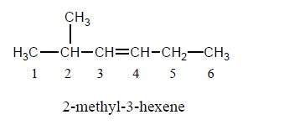
B. If the double bond is equidistant from each end, number so the first substituent
has the lowest number

Slide 7
3. If more than one double bond is present,
indicate their position by using the number of the first carbon of each double bond and use the suffix -diene (for 2 double bonds), -triene (for 3 double bonds), -tetraene (for 4 double bonds), etc.

Slide 8
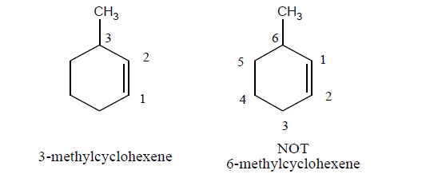
4. a. Cycloalkenes are named in a similar way.Number the cycloalkene so the double
bond carbons get numbers 1 and 2, and the first substituent is the lowest possible number.

Slide 9
b. If there is a substituent on one of the double bond carbons, it gets number 1.

Slide 10
Alkenyl group Alkenyl group is obtained by removing one hydrogen atom from an alkene. IUPAC name of the alkenyl group is given by replacing -ne of parent alkene with -yl. The carbon with free valence is always numbered first

Slide 11
Preparation of alkenes:
1-Dehydration of alcohol
The dehydration reaction of alcohols to generate alkene proceeds by heating the alcohols in the presence of a strong acid, such as sulfuric or phosphoric acid, at high temperatures.

Slide 12
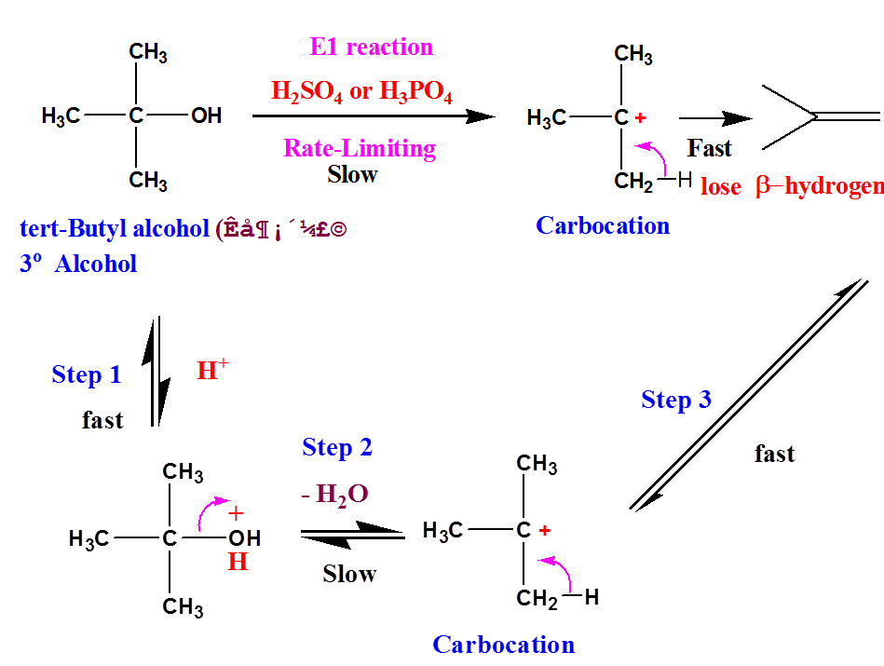

Slide 13
stability of ter.carbonium ion will be more than the sec.carboonium ion and that will be more stable than primary.

Slide 14
2-Dehydrohalogenation of alkyl halids:
Treatment of an alkyl halide with conc.strong base,such as solid KOH dissolved in ethanol, lead to elimination of HX and formation of alkene:

Slide 15
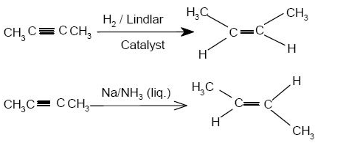
3-Redaction of alkyne
Alkynes can be reduced to alkenes using palladium supported over CaCO3​ or BaSO4​ and partially poisoned by addition of Sulphur or quinoline predominantly gives cis-alkenes which known as Lindlars reduction . Alkynes can also be reduced to trans-alkenes with sodium in liquid ammonia which is called Birch reduction

Slide 16
Reaction of alkenes
Addition reaction
1- Addition of hydrogen :H2
Is the addition of hydrogen H-H (H₂) to a carbon-carbon double bond ( π-bond )to give an alkane. The reaction must be catalyzed by metals such as Pd, Pt, Rh, and Ni.

Slide 17
2-Electrophilic trans addition of halogen
Halogens can act as electrophiles to attack a double bond in a lkene. Double bond represents a region of electron density and therefore functions as a nucleophile. How is it possible for a halogen to obtain positive charge to be an electrophile?

Slide 18
3-Adition of Hx(hydrohalogenation)
The hydrogen of the HX is add to the carbon of the double bond containing the greatest number of hydrogen .This rule is called Markownikoff rule.

Slide 19
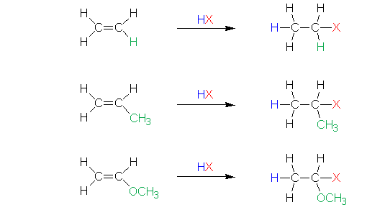

Slide 20
4-Addition of water
The addition of water to the alkenes ,called hydration ,required the presence of a strong acid catalyst such as sulfuric acid or phosphoric acid

Slide 21
Oxidation reaction
Oxidation of alkenes by KmnO4:
Alkenes react with cold dilute alkaline potassium permanganate solution to form 1,2-diols called glycols.The glycols contain two –OH groups on adjacent carbon atoms .This reaction of addition of two hydroxyl groups to each end of double bond is called hydroxylation of the double bond.

Slide 22
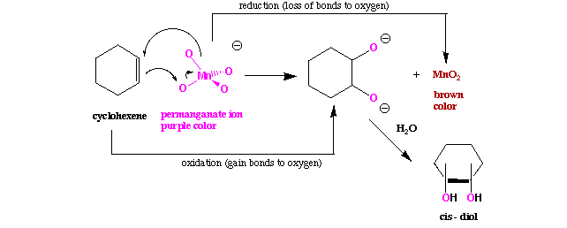

Slide 23
A hot acidic solution of KmnO4 is astrong oxidizing reagent that breaks both bonds of the double bond .The product s formed depended on the structure of the orginal alkene

Slide 25
Alkynes
Alkynes contain a carbon—carbon triple bond.
Terminal alkynes have the triple bond at the end of the carbon chain so that a hydrogen atom is directly bonded to a carbon atom of the triple bond.
Internal alkynes have a carbon atom bonded to each carbon atom of the triple bond.
An alkyne has the general molecular formulaC_{n}H_{2n-2}, giving it four fewer hydrogens than the maximum possible for the number of carbons present. Thus, the triple bond introduces two degrees of unsaturation.

Slide 26
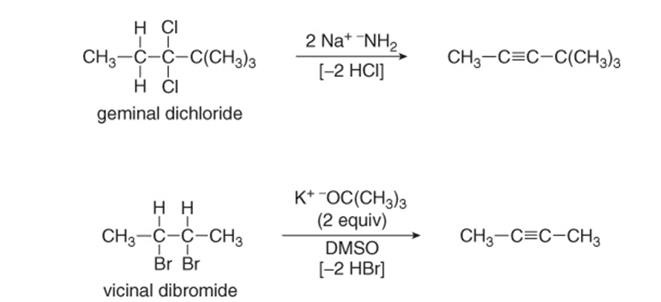
Preparation of alkynes 1-Dehydrohalogenation:-
alkynes are prepared by elimination reactions. A strong base removes two equivalents of HX from a vicinal or geminal dihalide to yield an alkyne through two successive E2 elimination reactions.

Slide 27
2- Acetylis
Terminal alkynes are weak acids .Reaction of strong anhydrous bases with a terminal acetylene produces an acetylide ion.

Slide 28
Acetylide ions can react as nucleophiles as well as bases Reaction with a primary alkyl halide produces a hydrocarbon that contains carbons from both partners, providing a general route to larger alkynes

Slide 29
Uses of acetylide ions
1-Qualitative Test for terminal alkynes.
2-Separation of a mixture of terminal and internal alkynes
Terminal alkynes form a precipitate with Ag or Cu salts ,internal alkynes do not react
Reaction with Ag(NH₃)₂NO₂:

Slide 30
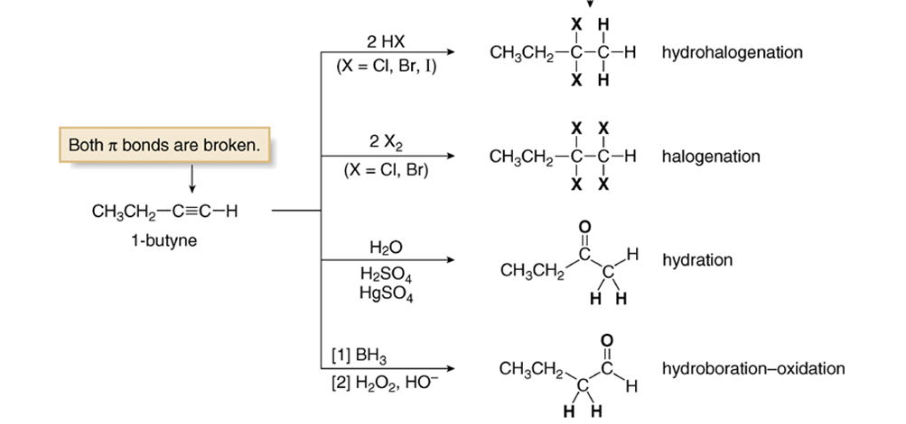
Reaction of alkynes

Slide 31
Oxidative Cleavage of Alkynes
Strong oxidizing reagents (O₃ or KMnO₄) cleave internal alkynes, producing two carboxylic acids
Terminal alkynes are oxidized to a carboxylic acid and carbon dioxide

Slide 32
